Slide 1

What is internet streaming
and how it works?
Lingyao Tang
Lambert Su

Slide 2
What is streaming?
Streaming is a technology used to deliver content to computers and mobile devices over the internet.
Broadcaster → Platform(CDN) → Viewers
→: data content, usually audio and video

Slide 3
Why streaming is important to us?
Important application of multimedia system
Quickest way to access internet-based content
Deliver audio and video contents
On-demand resources supports streaming apps

Slide 4
How streaming works?
Broadcaster → Platform(CDN):
relatively fast internet bandwidth
good computer hardware
streaming/video encoder(OBS)
RTMP

Slide 5
How streaming works?(cont’d)
Platform(CDN) → Viewers:
relatively fast internet bandwidth
video decoder(VLC player)
RTMP
http + flv

Slide 6
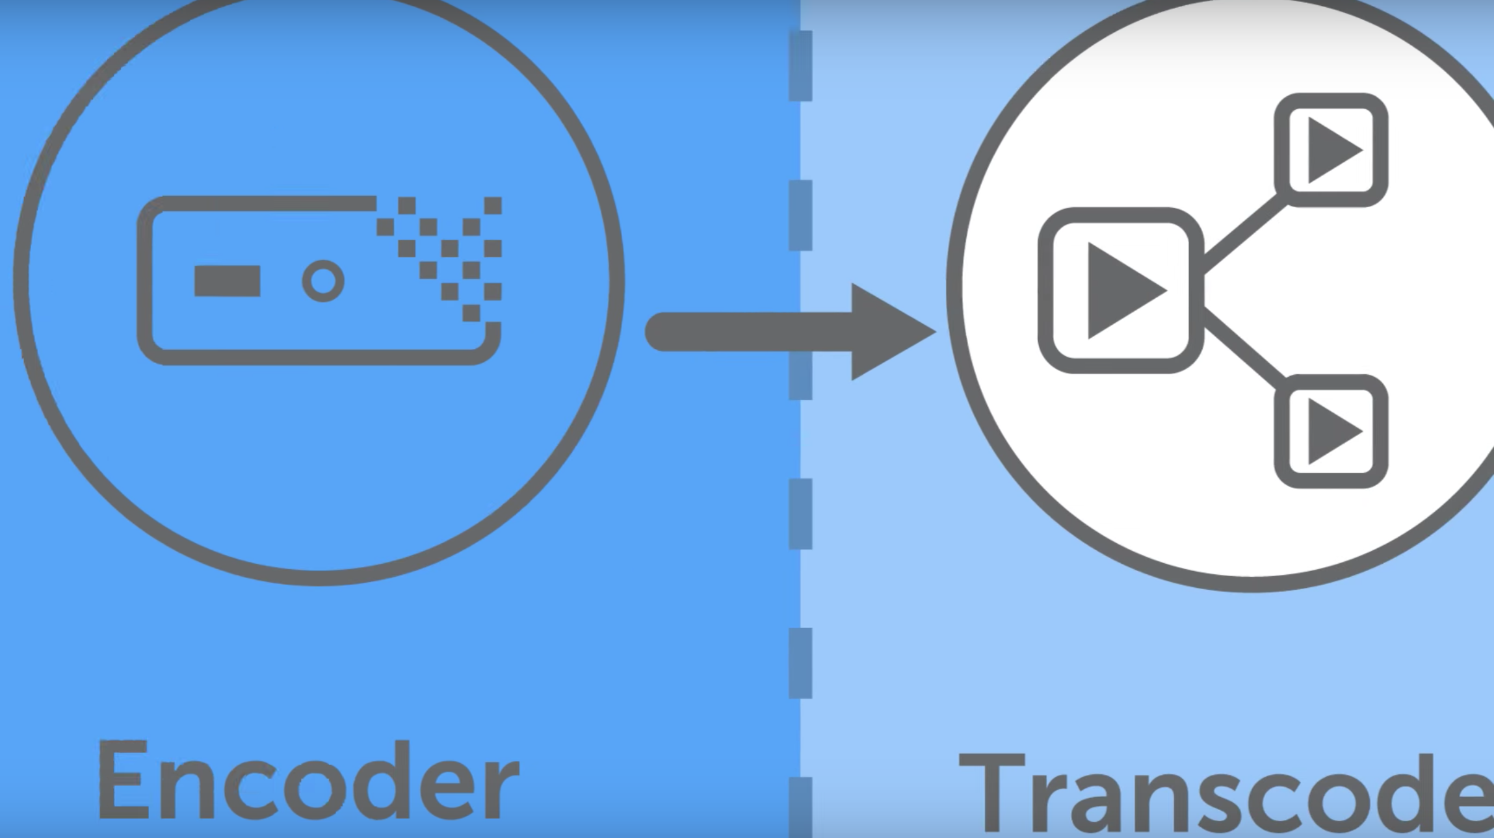
Basic concepts of streaming
Transcoding
Convert video to a form of data that computer can understand
Like converting cameras PL or ntsc format
to MP4 or MOV...

Slide 7
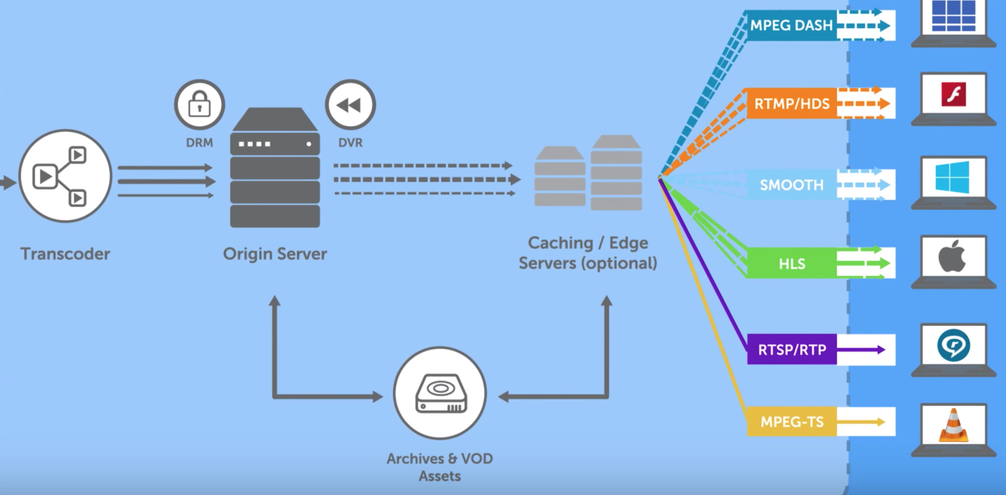
Basic concepts of streaming（cont’d）
Transmuxing
The process of changing video from one language to another
As different devices will require content to be delivered into different formats

Slide 8
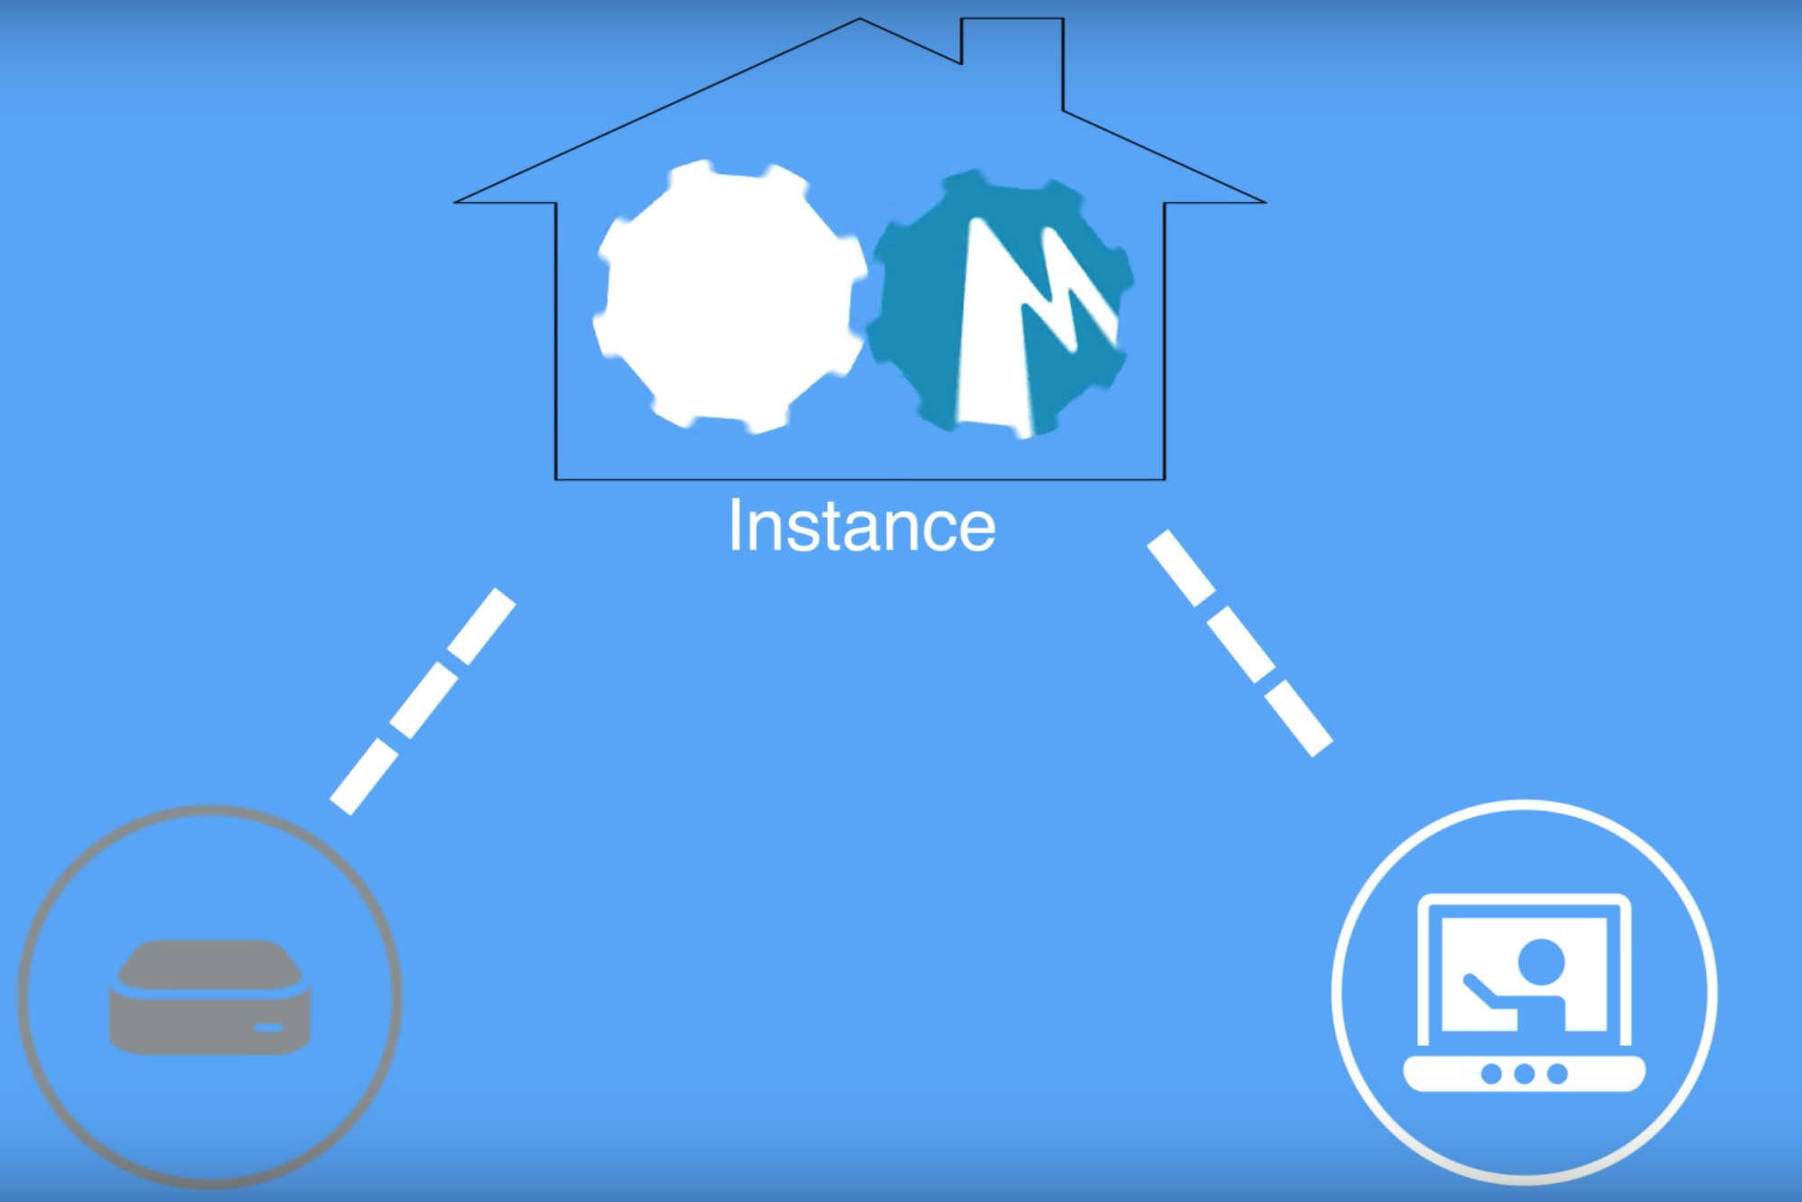
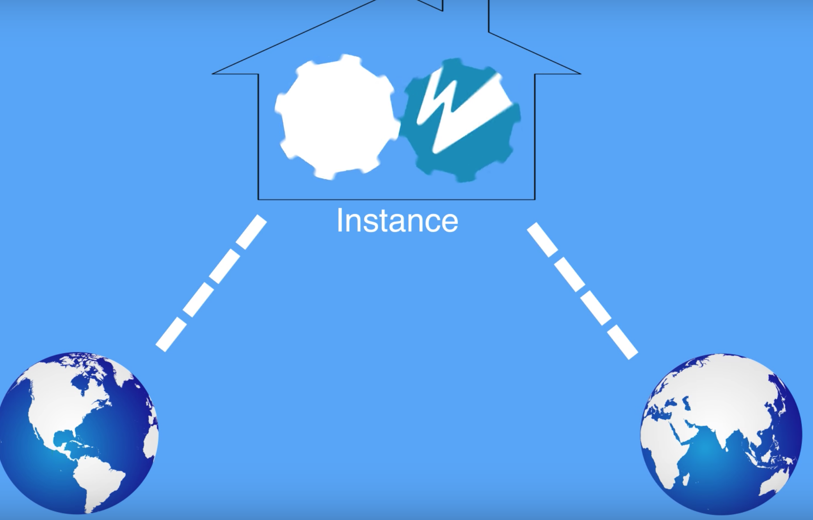
Basic concepts of streaming（cont’d）
Instance
Streaming engine that set up to do a specific job
Server that tells application to receive one location and the send to another

Slide 9
Some main issues during streaming
Low internet bandwidth
The stream will be relatively unstable even when lowering bitrates.
And this will lead to dropped frames or bitrate dips.

Slide 10
Some main issues during streaming (cont’d)
The physical distance among broadcaster, platform and viewers
The very long distance will lead to some noticeable delays.
Then, the stream will have some loading problems from the viewer’s view.

Slide 11
Some main issues during streaming (cont’d)
After receiving data, the platform needs to preload the data before sending them to the stream player
Need time to preload and if the speed is too slow, the delay will appear.

Slide 12
Some main issues during streaming (cont’d)
If the stream player has some features like [pause] and [play]
Adding these features like [pause], [play] even [back] is extremely hard for the most of platforms.
But if it is achieved, the QoS will be increased.

Slide 13
Solving these issues
The issues we talked above will be the main points for our final report.

Slide 14
Things to explore further
Live streaming platforms and apps
Add company copyright and brand
Support multiple video formats for audience side (MP4, rmvb, mov ...)
Support different video quality based on client side network speed

Slide 15
Things to explore further (cont’d)
Future development and consideration
The time delay caused from the distance between the platform and client side
Should the client side be able to have the function like pause and continue...

Slide 16
Questions?
Please, leave the questions in the comments section or the course forum.

